Slide 1
An attention-based hybrid deep learning approach for Bengali video captioning Md. Shahir Zaoad, M.M. Rushadul Mannan, Angshu Bikash Mandol, Mostafizur Rahman, Md. Adnanul Islam,Md. Mahbubur Rahman
Submitted by
Arpita Roy
ID: 23266026
Department of CSE
BRAC University
Submitted to
Annajiat Alim Rasel
Senior Lecturer
Department of CSE
BRAC University

Slide 2
Introduction
Video captioning is an automated process of textual captioning.
The importance of video captioning is because of the emergence of the significant number of videos on different platforms YouTube, Facebook, Netflix, Vimeo, etc.
Bengali is the 7th most spoken language by the total number of speakers in the world, that’s why the importance of Bengali video captioning is getting crucial.

Slide 3
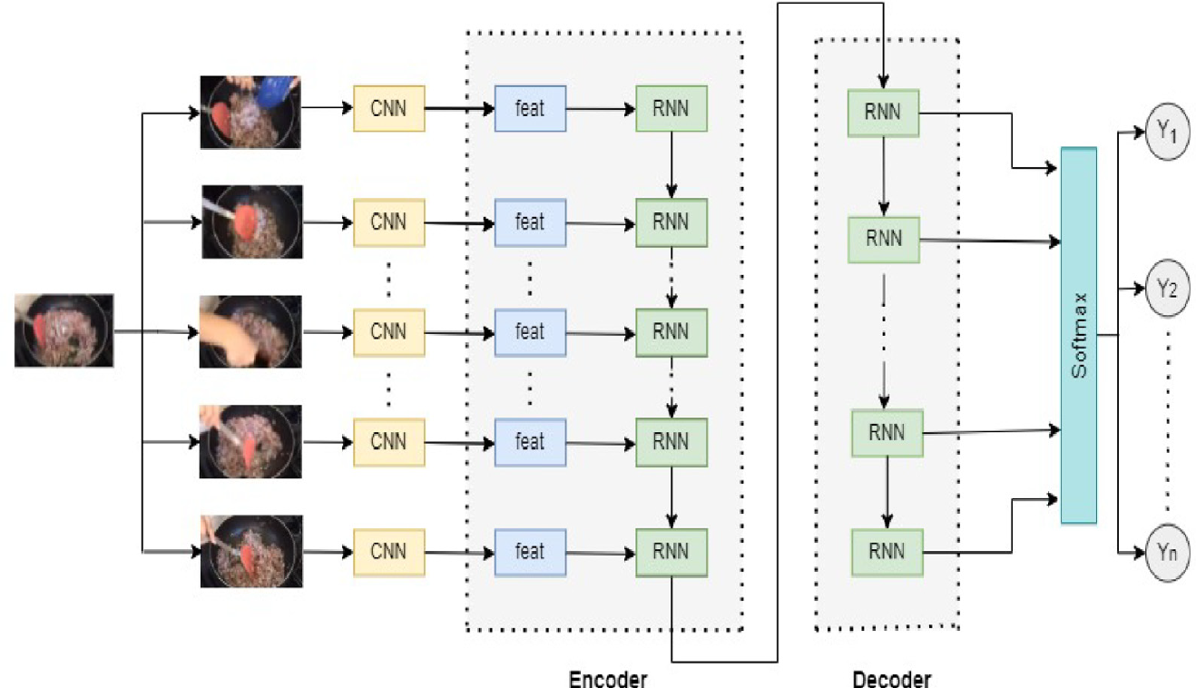
Methodology
This model is the combination of CNN-RNN models with attention mechanism.
CNN models: VGG-19, Inceptionv3, ResNet50v2
RNN models: LSTM, BiLSTM, GRU
Evaluation metrics: BLEU, METEOR, ROUGE
Here seq2seq model has used to reach from input to output.
Seq2seq Model:
Also addressed as an end-to-end model or encoder-decoder model. An encoder encoded input into a fixed-sized context vector and a decoder has generated output caption by utilizing the context vector. It used RNN models- LSTM, BI-LSTM and GRU.
Figure-1: Basic architecture of sequence-to-sequence model.

Slide 4
Methodology
How encoder encodes?
The encoder converted the input data into an intermediate representation, which the decoder decoded into a suitable output sequence that might not be exactly the same length as the input sequence.
Comprised of 80 cells in total, one for each frame.
How decoder decoded?
Utilized the encoder output vector (intermediate representation).
In the case of learning, on top of the encoder output vector, the decoder cells has intake the vector representation of the reference captions in order to learn the mapping function.
Initial step in this procedure was for the decoder's first cell to forecast the first vector by using the "bos" token.
To anticipate the second vector, the second cell used the results of the first decoder cell, and so on. Until the “eos” token has reached
LSTM:
LSTMs can handle the connection between recent past and present tasks even if the gap grows.

Slide 5
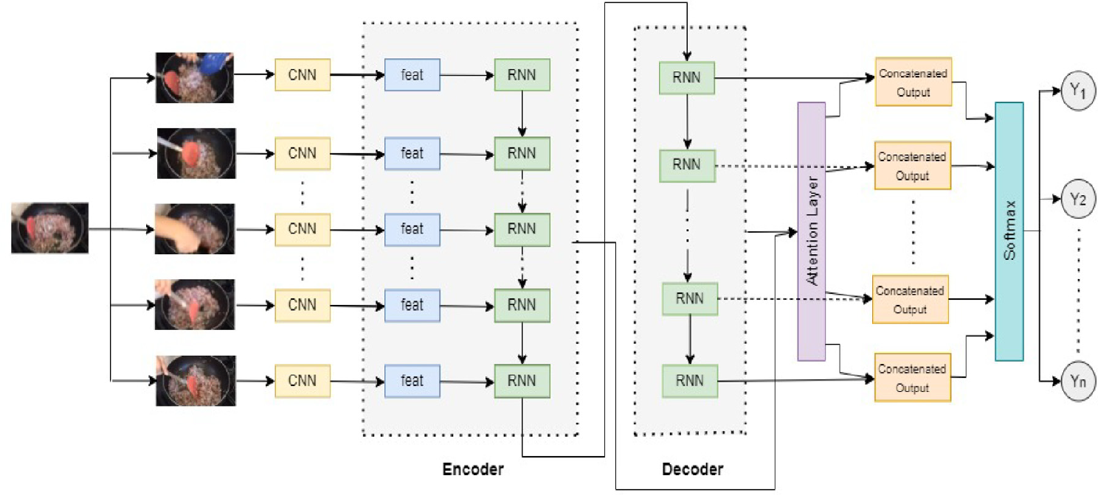
Methodology
BiLSTM:
BiLSTM architecture allocates the flow of information in both directions in a neural network; as a result, input information is preserved.
GRU:
The flow of information is controlled through gates.
Simpler architecture with fewer parameters and faster training capacity.
Figure 2: Video captioning using attention-based RNN

Slide 6
Methodology
Attention mechanism:
It developed a context vector to resolve the limitation of taking the entire input sequence, noticeably those that surpass one in the training dataset.
Word embedding:
It has done when the words with similar meanings will have an identical representation.
Feature extraction:
To understand the videos and distinguish between them, pre-trained CNN models have been incorporated to extract features from videos.
Optimization:
To minimize the loss or maximizing the accuracy, Adam optimization has used where it used the positiveness of Root Mean Square Propagation (RMSProp) and Adaptive Gradient Algorithm (AdaGrad).

Slide 7
Experimental setup
This model has used an IDE named Spyder where the codes were done in Python programming language but Google collaboratory was majorly used.
Deep learning library: Numpy, Tensorflow, Keras.
Hyperparameter selection:
Configuration | Epochs | Learning rate | ReducedLROnPlateau
Configuration-1 | 100 | .0003 | .1
Configuration-2 | 100 | .0003 | .01
Configuration-3 | 50 | .00003 | .1
Table- 1: Combinations of key hyperparameters

Slide 8
Experimental setup
Dataset:
A widely used English caption dataset named MSDV was used which was then translated into Bengali.
A sophisticated deep learning-based translator was used to translate 32000 English captions from 1450 videos.
Some errors have been encountered:
Slang words remain untranslated.
Bengali prefixes, suffixes, and several special characters (Unicodes), causing disappearance of valid letters and characters.
Bengali words were replaced by English words.
To address these issues manual efforts were also required.
After all processing, for training: 1450 videos and testing: 100 video snippets were used.
An 85% split ratio for training and validation purposes was used.
Training:
The main phase of learning was mapping between input and output with understanding the correlation between videos and corresponding captions where the main concern was- epoch.

Slide 9
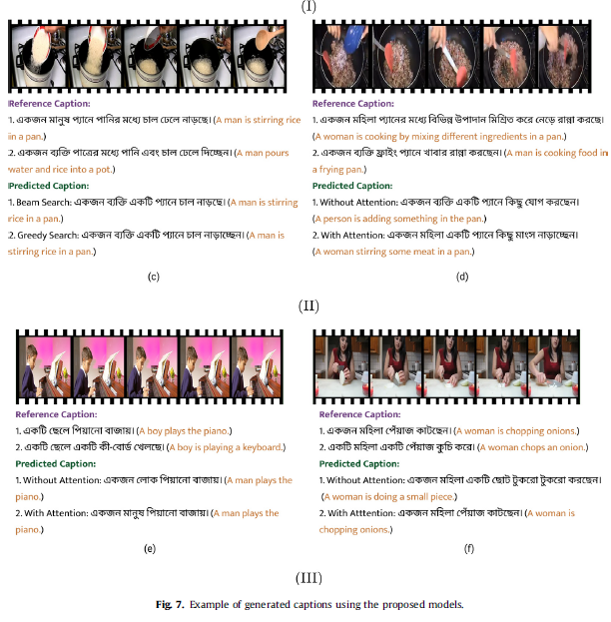
Result Evaluation
For the versatile performance evaluation, a comparative analysis was performed on the model’s performance using two different search techniques- Beam search and Greedy search corresponding with three popular evaluation metrics - BLEU, METEOR, and ROUGE.
Greedy search algorithm used for the local optimality to select a word for each stage to generate the caption, where decoding took less than 5-7 seconds.
Beam search algorithm, a heuristic search method, selected K=3 possible alternatives based on the conditional probability, where the search procedure halts for each sequence either by reaching the maximum length of 10 words and decoding took less than 45–70 seconds.
Qualitative analysis:
It has presented the proposed model sample outputs having all the best performances with and without the attention mechanism.
Figure- 3: Qualitative analysis n 35 video clips

Slide 10
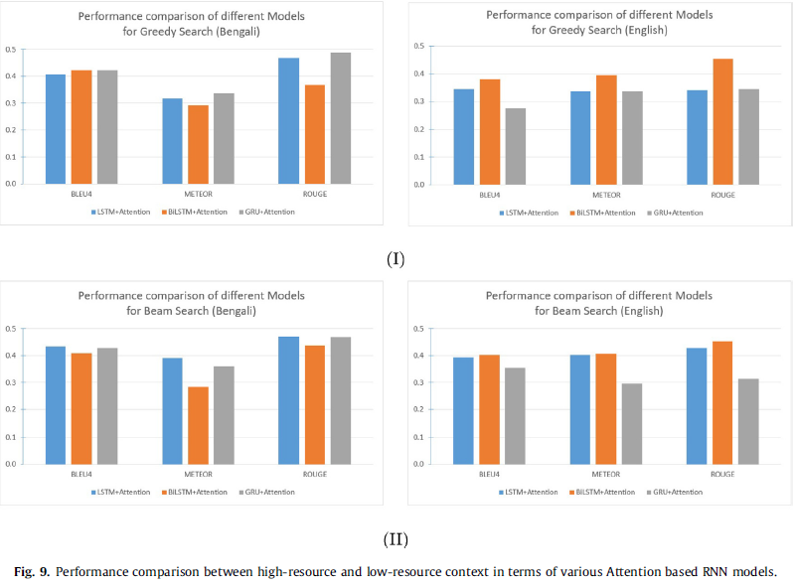
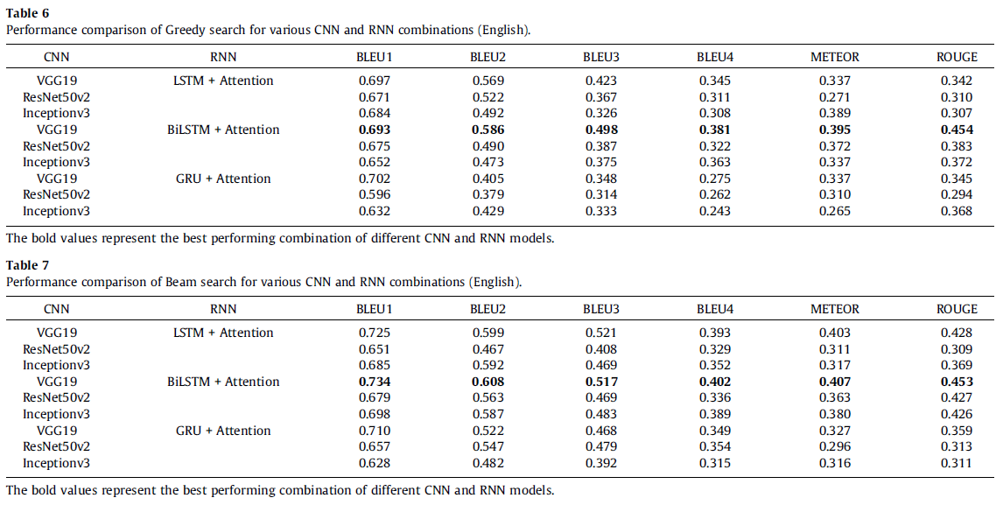
Result Evaluation
Performance Comparison:
Performance comparison of high resource context (English) and low resource context(Bengali) was done based on beam and greedy search where LSTM and GRU performed better because of the forward dependencies in Bengali than English.
Performance evaluation on English caption was done based on beam and greedy search where BiLSTM performed better because of the forward and backward dependencies in English.
Figure-4: Performance comparison
Figure-5: Performance evaluation on English

Slide 11
Accomplishments, Limitations and Future Work
Accomplishments:
Represents the best combination of CNN-RNN models with inevitable configurations.
Incorporation of attention mechanism.
Shows the comparative analysis based on performance between English and Bengali language captioning.
Developed a novel Bengali dataset from an English dataset.
Limitations:
Not applicable for the longer video clips
Do not generate longer captions
Error occurred after translation from English to Bengali captions.
Future Work:
Establishment of large corpus
Development of longer video clips along with longer captioning.
Detecting more than single options.
Email: arpita.roy1@g.bracu.ac.bd

